Slide 1
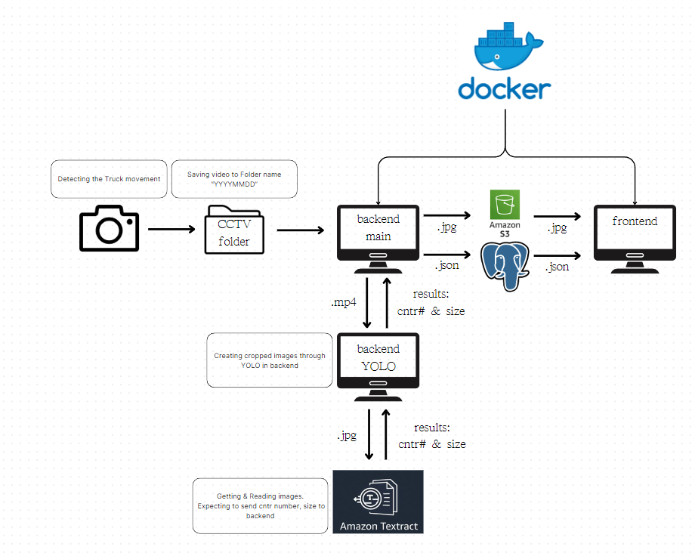
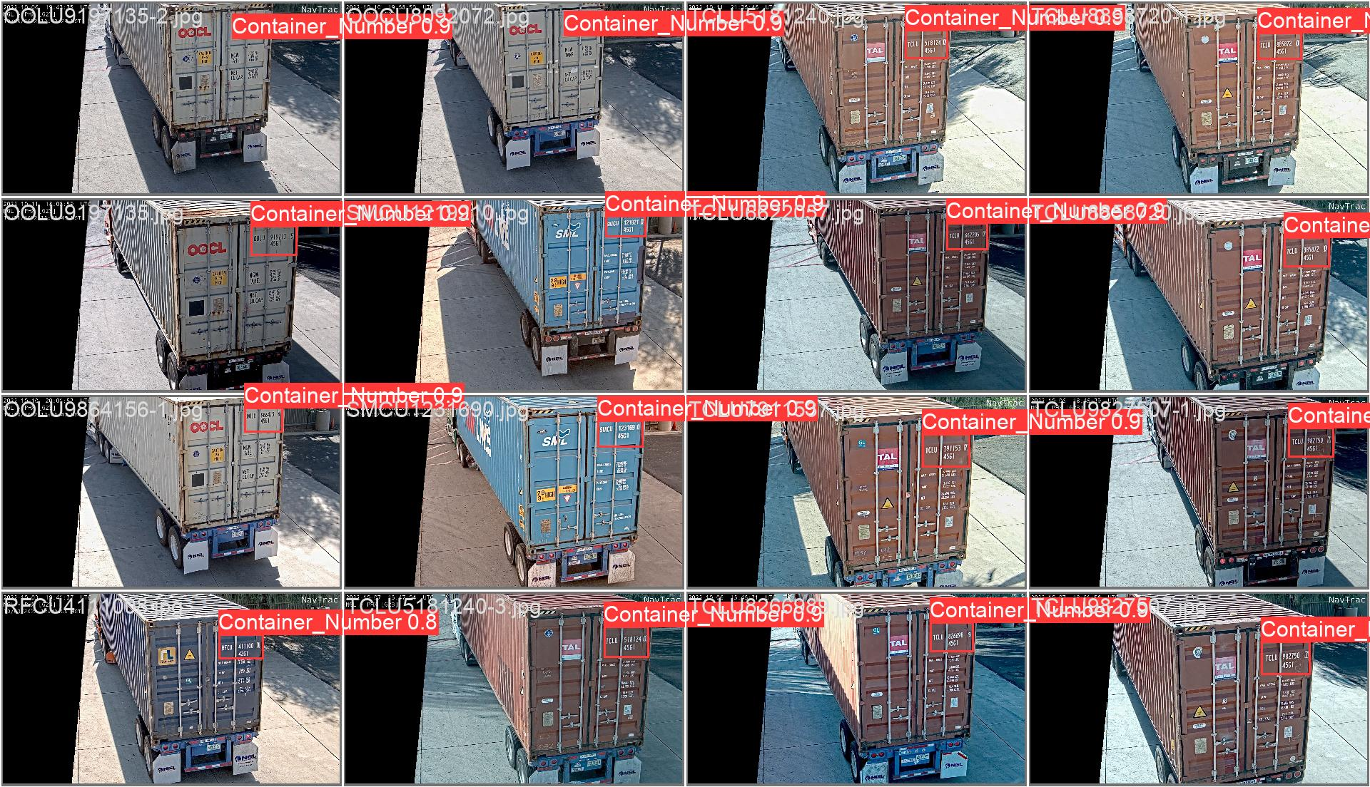
Building YMS (Yard Management System) using Machine Learning and Optical Character Recognition Technology
Jun Song, Computer Science
Mentor: Dr. Ryan Meuth, Associate Teaching Professor
ENGR Academic & Student Affrs
Introduction
Our project automates the identification and processing of container numbers at entry gates using machine learning (ML) and optical character recognition (OCR) technologies. This system optimizes logistics operations by reducing manual data entry errors, gate congestion, and processing times, thereby enhancing efficiency and accuracy in yard management.
WorkFlow_Chart
Sample image
Model
The image shows the results from our trained model, which identifies container numbers from CCTV footage. Developed with a dataset of 2,000 meticulously labeled images, this model effectively recognizes and extracts container numbers, enhancing the system's efficiency and reliability.
Main Technology
< YOLO (You Only Look Once) >
YOLO is a real-time object detection algorithm known for its speed and accuracy. It frames object detection as a single regression problem, predicting bounding boxes and class probabilities directly from full images in one evaluation. In our project, YOLO is used to quickly and accurately detect container numbers from video footage, streamlining the identification process at entry gates.
< AWS Textract >
AWS Textract is a machine learning service that extracts text and data from scanned documents and images. It goes beyond simple OCR by understanding the structure of documents, including forms and tables. In our project, Textract reads and interprets container numbers from images processed by YOLO, providing scalable and accurate OCR capabilities that enhance the efficiency of our logistics system.
< Language >
• Python • SupaBase • PostgreSQL • Node.js • Docker • AWS
In-Progress
Our current focus is on utilizing YOLO and OCR technologies to automate the reading of container numbers for integration with the logistics company's YMS System. We are developing a web application using Node.js and Supabase to streamline this process. For more details on this project, visit my personal website project page. - < https://songjeongjun320.github.io/project/ >
Stay updated with our latest progress through this LinkedIn post
- < https://www.linkedin.com/in/junsong0602 >
WorkFlow
< Detection and Video Storage >
Detects truck movement using CCTV cameras.
Saves the captured video to a folder named with the current date (YYYYMMDD).
< Backend Processing >
The main backend processes the video file (.mp4) and extracts relevant images.
YOLO model in the backend crops images to focus on the container, extracting container number and size information.
< OCR and Data Extraction >
Processed images are sent to AWS Textract.
Textract reads the images to extract the container number and size, returning the results to the backend.
< Data Storage and API Integration >
Results (container number and size) are formatted into JSON.
JSON data and images (.jpg) are uploaded to Amazon S3 for storage.
The PostgreSQL database stores extracted data for backend use.
< Frontend Integration >
The frontend retrieves data and images from Amazon S3.
Displays the processed information on the user interface.
< Docker for Containerization >
Docker is used to containerize the entire application, ensuring consistency and scalability across different environments.
Future Works
Our future plans include:
Enhancing the accuracy and speed of our OCR model.
Expanding the system to handle additional logistics tasks.
Improving the user interface of our web application.
Integrating more advanced AI and ML algorithms to optimize operations further.
By continuing to innovate and develop our system, we aim to provide comprehensive solutions for the logistics industry, making operations more efficient and accurate.
Project Insight
AI and machine learning will revolutionize industries by automating repetitive tasks, enhancing decision-making processes, and providing insights through data analysis. In logistics, these technologies will streamline operations, reduce costs, and improve accuracy, ultimately leading to more efficient and responsive supply chains. As AI continues to advance, its impact will extend beyond logistics, transforming various sectors including healthcare, finance, and manufacturing. This transformation will contribute to smarter, more efficient operations globally, fostering innovation and improving quality of life by addressing complex challenges and optimizing resource management.
References
Handwritten optical character recognition (OCR): A comprehensive systematic literature review (SLR)
OPTICAL CHARACTER RECOGNITION TECHNIQUE ALGORITHMS.
YOLOV: Making still image object detectors great at video object detection
A vision-based application for container detection in Ports 4.0
Ai city challenge 2020-computer vision for smart transportation applications
A real-time precrash vehicle detection system

